Slide 1
Metagenomics
Best Practices, Best Tools
Notes:
So for this next section Im going to go through some approaches in metagenomics, and this is in some ways the most convoluted of the different ’omics approaches we’ve looked at today, because its often many approaches under on umbrella.

Slide 2
Structure
AIM:
Help you understand strategies used in metagenomics experiment
Experimental Aims
Pipelines and Tools
Metagenome Taxonomy
Metagenome Function
Metatranscriptomes
Notes:
And the main aim will be to give you again, the 1000 mile up view – to help you understand the strategies used in metagenomics experiments
Particularly the experimental aims and pipelines people use as they apply to the three main domains in metagenomics, the Taxonomical classification, Functional classification and the use of transcriptomics approaches

Slide 3
What is metagenomics?
Environmental genomics
Samples of mixed genomes, from some place
Microbiomes
e.g genomes of microbes in soil samples
Plant Pathogen Infection
e.g field pathogenomics
Not so much marker gene surveys
eg. 16S
Effective way to profile structure and function of communities
Notes:
So its probably a good idea to come up with a working definition of metagenomics – Metagenomics as a word is a bit of a poor choice, it doesn’t express much in itself and its used loosely sometimes. I think a good way to think of it is as Environmental Genomics. As a way of looking at samples with lots of mixed up genomes from some place.
This is in contrast then to the normal genomics in which we sequence just one thing, like a plant or a cultured micro-organism.
And the main sort of metagenomes we tend to think of are those come from microbiomes so a soil sample, but also sequencing disease infected plant tissue in infection studies or in field pathogenomcs is a set of mixed up genomes, so you can think of that as metagenomics too.
Before NGS people used to use select genes rather than whole genomes, such as 16S rRNA genes, with NGS people still do this on a wider scale, but there are some voices out there that will shout – this isn’t metagenomics – but I will cover a little bit about those approaches

Slide 4
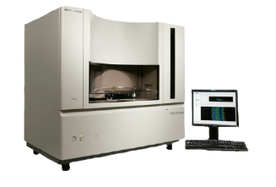
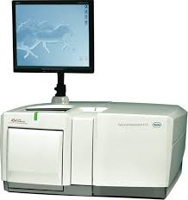
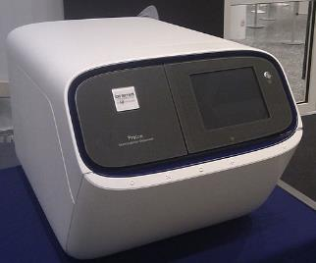
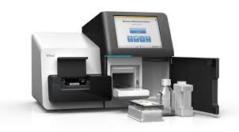
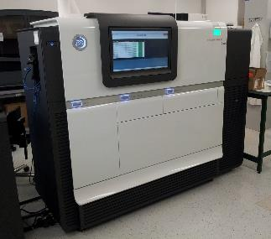
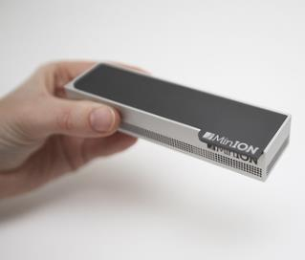
Metagenomics Sequencing
Roche 454
Sanger
Ion Torrent
Nanopore
Illumina *Seq
Pacific Biosciences
Notes:
Ok, the sort of sequencing that gets used is nowadays mostly the Illumina and PacBio sequence, marker gene studies in the past used the familiar Sanger and some earlier deep metagenomics studies used 454 which is a somewhat outdated medium throughput, short length sequencing, and you’ll
Most use Illumina now though its expected that the nanopore - which is a tiny handheld sequencer will become more used in the field in the coming years.

Slide 5
Data Quality Issues
Sequencing errors
Error rates, error type (PacBio: 10% random, Illumina – 0.1% substitution)
Chimeras
Amplification artifacts, cloning of restriction fragments
Notes:
The first step after you get your sequence – whatever you’re going to do with it ultimately– is preprocess and try to ensure data quality.
Sequence data isn’t 100 percent accurate, in fact each base comes with an associated probability of being wrong – and you can use that to improve the integrity of the data as a whole.
Different types of sequence data have different rates and patterns – PacBio has a huge 10% error rate at its worst– but theyre random errors without any systematic bias, Illumina has a 0.1% errors which are mostly substitutions.
There are errors that come from other steps in the pipelines, so the cloning and amplification steps can introduce molecules and sequences that aren’t present in vivo but can seem quite abundant and real in the data downstream and these have to be avoided.

Slide 6
PreProcessing
FASTQC plots quality scores and sequence metrics and allows development of filter thresholds for whole sequence sets
before
after
Notes:
One very useful tool for examing the quality of your sequence is fastqc. Basically it will draw boxplots of the distribution of quality scores in each position in each read, so the y axis here is the position in the read and, here’s a set before processing where the quality of the bases drops off fairly drastically as you go to the end. The right panel shows a better sequence set after throwing out the bad reads or bases.

Slide 7
PreProcessing
Trimmomatic uses a sliding window approach from the 5` end to identify low quality regions which are then trimmed from the 3` end. Reads < 36 bp are discarded
Notes:
A program like trimmomatic is something you can use to actually do the quality control, this will throw out poor or too small reads but also slice off sequencing adapters or poor quality sequence from the start or end of reads allowing you to retain and work with only the good bits.

Slide 8
Metagenomics approaches - Summary
Who’s There?
What Are They Doing?
How much are they doing it?
Functional
Annotation
RNASeq
Marker Gene
Taxonomic Binning
Assembly
Expression
Notes:
Right so when we have good sequence we can start to analyse it .
There are basically three questions we’d want to ask in metagenomics.
Firstly, who’s there – which organisms are in the sample. And these pipelines usually start off with some sort of taxonomic classification of reads, though assembly of reads can help improve specificity of that.
Then there’s What are they doing – which tries to use databases to work out what biochemcial pathways are prevalent in those organisms, again this sort of annotation can be improved by assembling sequences first
And there’s also – How much are they doing it – this is an RNASeq based metatranscriptomics piepline that like functional annotation can be improved by assembly and even by separating the reads into different clades before assemlby and creating gene expression estimates.
And I’ll go through each of these individually.

Slide 9
Metagenome Taxonomy
Who’s there?
Extract DNA
Sequence random fragments
QC
Diversity analysis
Notes:
So here’s the basic pipeline for a metagenome taxonomy experiment, its really quit brief, you get your DNA, you sequence it, you do QC and head to diversity analysis,
But even when you’ve got a really good set of sequence data, you still have some potential pitfalls in the nature of the data itself.

Slide 10
Metagenome Taxonomy
Who’s there?
Goal: Identify the relative abundance of different microbes in a sample
Problems:
Reads are all mixed together
Reads can be short (~100bp)
Two broad approaches
Binning Based
Marker Based
Notes:
The biggest problem is that of course, all the reads are mixed together regardless of what species they come from. Depending on the sequence type then the reads can be short and short reads are harder to specifically pin down to a particular origin.
The two main approaches are the binning based or marker based approaches.

Slide 11
Binning Methods
Attempts to “bin” reads into the genome from which they originated
Composition-based
Uses GC composition or k-mers (e.g. Naïve Bayes Classifier)
Generally not very precise and not recommended
Sequence-based
Compare reads to large reference database using BLAST (or some other similarity search method)
Reads are assigned based on “Best-hit” or “Lowest Common Ancestor” approach
Notes:
A binning method is basically a technique that tries to group each read with all the others from the same genome.
Some studies out their have used stuff like GC composition of reads to create bins, though this is pretty poor when it comes to bein accurate about what the actual species is
Much more powerful are the sequence based methods that use databases of sequence of known origin as a reference and basically blast the sequence against that. The idea is that the best hit in the database or more often the lowest common ancestor between hits is the proper taxonomic classification.
Although I say blast, really it isn’t blast that gets used – its too slow - but some sort of similarity search method

Slide 12
Binning Tools
Notable Examples:
MEGAN: http://ab.inf.uni-tuebingen.de/software/megan6/
One of the first metagenomic tools
Does functional profiling
Notes:
Software that implements this easily are quite abundant, the best and most famous is probably MEGAN, now on version six, which does an awful lot of stuff incuding functional annotation, can handle lots of file formats and different taxonomies.
It also produces end result visualisations like bar charts and word clouds and will generate some statistics. It doesn’t do similarity searches directly but can work with a companion package called diamond that does.
And it’s major advantage to a beginner is that it has a graphical interface to work with

Slide 13

Binning Tools
Notable Examples:
Kraken: https://ccb.jhu.edu/software/kraken/
Fastest binning approach to date and very accurate.
Large computing requirements (e.g. >128GB RAM)
Notes:
The most powerful and most accurate tool at the moment is a command line driven tool. Its called Kraken and it works in timescales of minutes to hours by use of a clever algorithm for similarity search. Its actually fairly straightforward to use but it can have huge memory use in some steps, especially if you’re looking to create custom taxonomic databases. The authors do provide some pre-compiled databases so if you don’t have special requirements then you might have an easier time. The

Slide 14
Marker Methods
Single Gene
Identify and extract reads hitting a single marker gene (e.g. 16S, cpn60, or other “universal” genes)
Use existing bioinformatics pipeline (e.g. QIIME.)
Multiple Gene
Several universal genes
PhyloSift Uses 37 universal single-copy genes
Notes:
Ok, so briefly about Marker based methods, these work either by identifying known universal genes, like the 16S rRNA and there are tool for this, like QIIME.
Some others use multiple supposedly universal single copy genes – so you have to make a call as to whether you really think the genes selected are useful and discriminatory, these are mostly useful for microorganism metagenomics and don’t handle plant tissue so well.

Slide 15
Marker vs Binning
Binning approaches
computationally intensive
Doesn’t always reflect organism abundances due to genome size
Marker approaches
Doesn’t allow functions to be linked directly to organisms
Genome reconstruction not possible
Very sensitive to choice of markers
Notes:
So

Slide 16
‘left-over’ Reads
What about the reads that can’t be classified?
Errors?
Novel Sequence?
Just not in database?
Try assembling the left-overs
Notes:
So what if you do a binning experiment but not all the reads can be binned? This isnt just because the reads are wrong, the database may lack sequences matching yours because its novel are divergent or the db isn’t wide enough.
You can always try assembling the leftovers,

Slide 17
What about assembly?
Assembly is often used in genomics to join raw reads into longer contigs and scaffolds
Notes:
So briefly assembly is the process by which short DNA frgament get built into longer ones, usually by a process that calculates read overlap then compresses the overlap sequence into longer sequence and uses other information like known distance between reads to build a longer scaffold

Slide 18

Metagenomic assembly
Notes:
In single genome genomics the assembly problem is often likened to putting back together a book after it has been shredded.
Well in metagenomics, it is far more difficult, its more like putting a bookshelf back together after shredding soif you are going to do assembly then you need to be aware of the problem of chimeric contigs – bits of the assembly that arent real and are the result of fusion of similar sequences from different organisms

Slide 19
Metagenomic assembly
Specific assemblers
IDBA-UD,
Meta-IDBA,
Meta-Velvet,
Ray Meta,
Meta-Cortex
Validation
LAP,
ALE,
QUAST,
FRCbam,
REAPR
Analysis Pipelines
MetAMOS
Notes:
And some specific metagenome assemblers have been developed, including variants of some standard assemblers, the important thing is to assess the quality of assemblies and there are correspondingly lots of programs for this.
Thankfully, as this is a hard problem then these tools have been wrapped into pipelines, a pipeline called MetAMOS will allow you to run all of these tools at various settings and assess the results in one overarching wrapper. MetAMOS produces plots, classifications and sequence metrics as well as being compatible with assembly visulaisation tools like hawkeye.

Slide 20
What do we mean by function?
Metagenome Function
What are they doing?
General categories
Photosynthesis
Nitrogen metabolism
Glycolysis
Specific groups of orthologs
EC: 1.1.1.1 (alchohol dehydrogenase)
K00929 (butyrate kinase)
Notes:
So the next question, once we know what is in our sample can often be, what are they doing – basically this is what genes do they have, is there anything community specific in there.
And this means putting an annotation onto the genes or sequences that we have. This can be a general fairly high level sort of categoric annotation such as saying the gene is involved in photosynthesis or nitrogen metabolism. But also its often useful to get much more granular annotation, so identifying orthologs and individual enzyme functions. So what you end up with is for each sequence, a list of technical terms that describe what it does, and you can analyse those lists to test hypotheses about whats your metagenome does.

Slide 21
Metagenomic Annotation tools
Pros
Less computation time for annotation
Can allow annotation when reads are too short (<100bp)
Can sometimes partially reconstruct genomes
Cons
Reads are not all from the same genome so chimeras can be formed
Read depth is often not as deep as in genomics which makes assembly fail
High organism diversity can cause assembly to fail (subsampling may help)
If calculating abundance of genes then reads collapsed by assembly must be added back in post-annotation (MetAMOS does a good job of this)
Can bias results since some organisms/genes will assemble easier which will result in those features being falsely over-represented

Slide 22
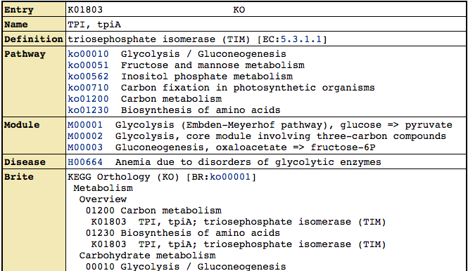
KEGG for functional annotation
KEGG Orthologs (KOs) http://www.genome.jp/kegg/ko.html
Most specific. Thought to be homologs and doing the same exact “function”
~12,000 KOs in the database
These can be linked into KEGG Modules and KEGG Pathways,
Identifiers: K01803, K00231, etc.
Notes:
One extremely popular database for annotation is the KEGG database, which holds a collection of orthologs across species thought to be doing the same function so useable across species. They’re simple annotations like this one and have a K-number identifier

Slide 23
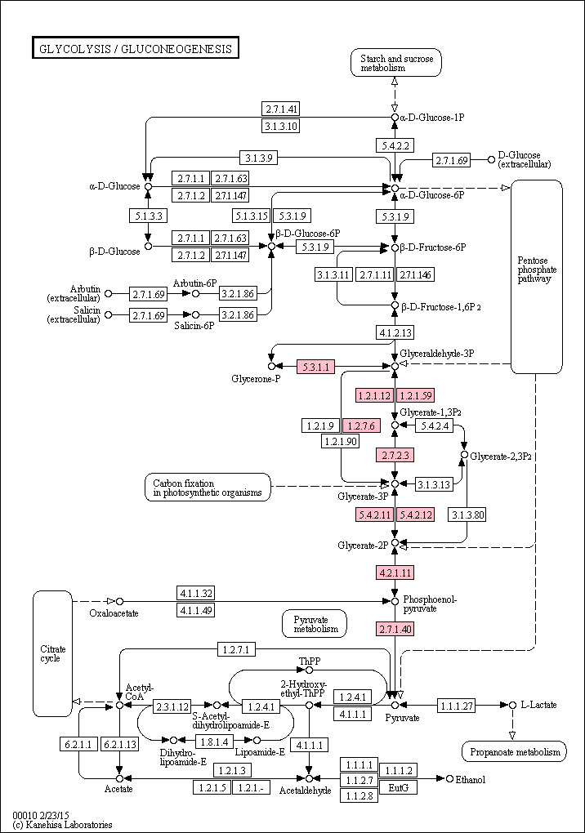
KEGG for functional annotation
KEGG Pathways
Groups KOs into large pathways (~230)
Each pathway has a graphical map
Individual KOs or Modules can be highlighted within these maps
Pathways can be collapsed into very general functional terms (e.g. Amino Acid Metabolism, Carbohydrate Metabolism, etc.)
Notes:
Kegg is most powerful because it groups its orthologs into large metabolic pathways for high-level functions and each as map like this so its possible to illuminate pathways that are present

Slide 24
Metagenomic Annotation tools
Web-based
EBI Metagenomics Server
MG-RAST
IMG/M
Koala
GUI-Based
MEGAN
Allows connection between taxonomy and function
ClovR
Virtual Machine based - microbial
Local-based
Prokka
MetAMOS
Built in assembly, highly customizable,
DIY
Set up your own in-house custom computational pipeline
Notes:
And again annotation of sequences is done by a large number of tools, heres some online ones, Koala is the KEGG tool. There’s also a couple of GUI ones including megan that I mentioned earlier, and a couple of locally run ones, prokka is ideal and fast for prokaryotes and MetAMOS as we’ve discussed wraps an awful lot of other tools for a quite comprehensive annotation.
That said though, these tools don’t find everything, often there are classes of genes that are specific to a particular community, for example effector proteins and R genes in the plant disease field. These won’t get annotated specifically as such by any of these tools so there often needs to be custom parts of the pipeline to catch and annotate the genes you are interested in yourself. So you might run a filter to find a gene with transmembrance domains, signal peptides, LRRs etc and classify this accordingly.

Slide 25
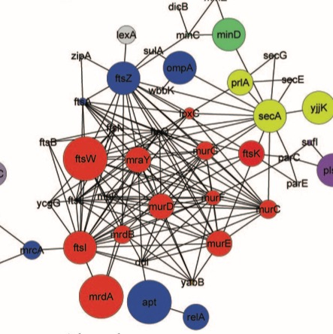
Metatranscriptomics for community activity
Functional Quantification
Use RNA-Seq to determine which genes and pathways are being actively expressed within a community
Genes involved in pathways associated with cell wall biogenesis
Relative abundance of transcripts
Relative abundance and contributing taxa
Notes:
So moving on from identifying what functions are there, it is possible to use RNAseq in metatranscriptomics to reveal which genes are active at a given time and in combination with the
Taxonomical approaches it can also reveal which taxa are responsible for the active functions, giving a large amount of deep information about what is going on in a microbiome or interaction. So in these graphs we can see the circles are genes and the size of the circle is the abundance of those transcripts and the areas on the Pie charts show the taxa that are contributing to the transcript abundance.

Slide 26
Metatranscriptomics: Assembling to annotate
contig1
contig2
Notes:
Again this approach is facilitated by assembly,
First of all assembly is different with transcriptomics data because of the highly variable coverage of each sequence due to transcript abundance and the increased likelihood of chimeras from reduced sequence space, and problems generated by transcript isoforms, so transcriptome assemblers are useful and these Including cufflinks, Oases and trinity.
Taxonomic binning prior to assembly can assist by grouping reads into species specific bins.
But once you have an assembly, it again improves annotation accuracy, This graph shows a heatmap of different assemblers and paramaters and the proportion of contigs annotated with a known gene at different contig lengths. As the contig length grows then the proportion of contigs with a recognisable gene in there increases.
Trinity appears to provide best performance in terms of reads that can be annotated from this study, but each dataset will be different and again optimisation and validation will be crucial to getting a good solid answer.

Slide 27
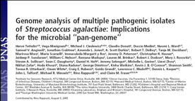
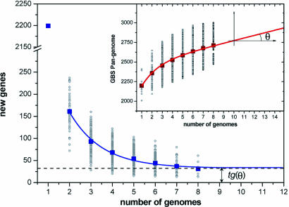
7. Read processing – functional annotation
Functional annotations rely on the identification of sequence similarity searches using tools such as:
BWA, BLAT and BLAST
While fast, BWA and BLAT rely on near perfect matches to reference genomes
However sequence diversity is huge!
Every time a new strain of S. galactae was sequenced, new genes are discovered that were not present in existing strains
Diversity at the nucleotide level is >> protein level

Slide 28
Metatranscriptomics: Mappings to expression
Normalize counts for expression levels –
to account for differences in gene length, read counts are converted to Reads per kilobase of transcript mapped (RPKM)
Raw count
RPKM
8
1
24
6
8
12
RPKM_{geneA} = 10⁹ C_{geneA} / NL
C_{geneA} = number of reads mapped to geneA
N = total number of reads
L = length of transcript in units of Kb
Cufflinks
Trinity
Bioconductor in R
EdgeR
DESeq
Notes:
Once you’ve got the transcripts and want to quantify, you can’t just take the absolute number of reads
Expression is biased for gene length (longer transcripts should have more reads) to normalize, reads are converted to Reads per Kilobase of transcript per million reads mapped
Which can completely overturn the counts but gives
Several software tools available to do mapping and calculate normalized expression measurements across different samples including Most RNAseq programs like Cufflinks and trinity nd statistics modules like the Bioconductor packages DESeq, and EDGER can help with calculating these values

Slide 29
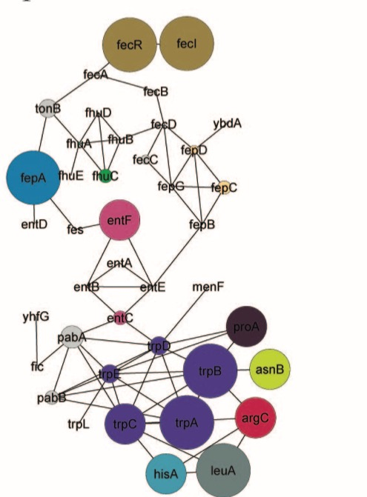
Metatranscriptomics: Understanding results
How do we identify those systems which are differentially regulated across samples (e.g. systems up-regulated in disease vrs. health)?
Gene Set Enrichment Analysis
- Node Size = number genes with an annotation
Network analysis
– genes with related function and similar
changes in expression
Notes:
Once you’ve got the values then you’ll likely start to compare systems across samples
Does need robust statistics – and that’s a training day in itself so I won’t touch on it. but as a prelimiinary visualising is very helpful
A technique calledd Gene set enrichment analysis (GSEA) gathers discrete groups of functionally related genes and can say whether they are more apparent in the set than otherwise
GSEA may define trpA-E
as a single group of
related genes, but group
as a whole may not be
significantly upregulated
An alternative and more involved network approach can identify groups of genes based on functional interactions AND their differential expression to identify pathways rather than prescribed gene sets.

Slide 30
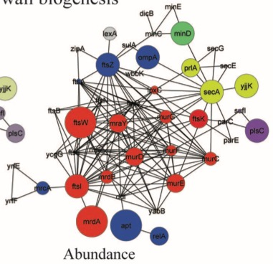
Metatranscriptomics: Understanding results
Cytoscape
www.cytoscape.org
MeV
www.tm4.org/mev.html
R
D3.js
Genes involved in pathways associated with cell wall biogenesis
Relative abundance
Relative abundance and contributing taxa
Notes:
And this can be done in GUI based programs like Cytoscape which allows drawing of networks and the mapping of dimensions of data on top, like this arabidopsis gene activity network
In addition to representing protein interaction or metabolic relationships through network visualization, Cytoscape offers the ability to represent nodes (proteins) as pie charts or donuts, allowing the visualization of taxonomic contributions to discrete functions – the graph I showed you earlier is a cytoscape one.
For those of you who want to program your visualisation, R has a lot of useful functions for this, and libraries like the javascript d3 library are extremely powerful, if a little opaque.

Slide 31
Metagenomics approaches - Summary
Who’s There?
What Are They Doing?
How much are they doing it?
Functional
Annotation
RNASeq
Marker Gene
Taxonomic Binning
Assembly
Expression

